Slide 1
Student Admission & Branch Information / Management

Slide 2
Overview
Purpose:-Simplifies student admissions and branch information management.
Key Features:-View branches and their details.
Manage admissions and cancellations.
Save student records for future reference.

Slide 3
Technologies Used
Content Overview:-C Programming Language
This program is written in C to manage student admissions and store data.
Libraries Used
stdio.h: Provides input/output functions like printf and scanf for user interaction.
stdlib.h:-Used for functions like system() to clear the screen and exit() to terminate the program.
string.h:-Provides functions like strcpy() to manipulate strings, such as storing student names.
File Handling
The program saves student admission data to a file (admissions.txt) using fopen(), fprintf(), and fclose() functions, ensuring that admission records are stored even after the program exits.

Slide 4
System Architecture
Main Components: The program features a menu-driven interface, allowing users to interact with the system through options such as viewing branch info, managing admissions, and handling file storage for data persistence.
Data Management: The program uses arrays to store data on:
Branches
Heads of Departments (HODs)
Subjects
Student records (names and branch selections)

Slide 5
Key Features
Content:-
View Branch List
Admission Management
View All Admissions
Cancel Admission
Branch Information

Slide 6
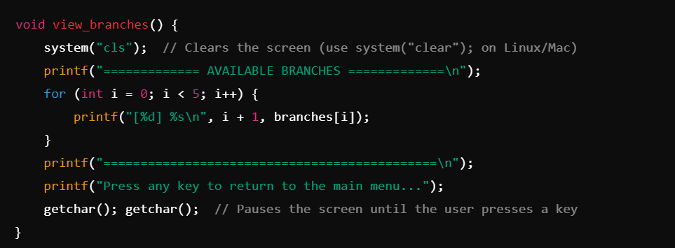
Overview of View_branches() Function

Slide 7
Overview of View branches() Function
Clear the Screen:– The system("cls") command clears previous output, providing a clean display. This improves readability by focusing the screen solely on the branch list.
Show Numbered Branches:– A loop prints each branch in a numbered format, pulled from the branches array. The numbers help users quickly identify each branch for future selections.
Footer and Prompt to Continue:– After listing branches, the program displays a line and a prompt, instructing users to press any key to return to the main menu. A get char() call pauses the program, giving the user time to review the list.
Return to Main Menu:– Once the user presses a key, the function ends, and the main menu reappears.

Slide 8
Admission Management
New Admission
Purpose: Adds a new student to the system.
How It Works: The program asks for the student’s name and branch choice. It then saves this information both in the program and to a file called admissions.txt.
Result: Confirms admission with a message. If the user picks an invalid branch, it shows an error.
View Admissions
Purpose: Lists all students who have been admitted.
How It Works: If there are admissions, it displays each student’s name and branch. If no admissions are found, it tells the user.
Result: The user can quickly view all admitted students.

Slide 9
Cancel Admission
Purpose: Allows the user to remove a student from the list.
How It Works: The program asks for the admission number to cancel. If the number is valid, it removes that student’s details and shifts the rest of the list up.
Result: Shows a message confirming the admission was canceled.
Branch Information
Purpose: Shows details about each branch, like the HOD (Head of Department), subjects, fees, and seat availability.
How It Works: The program displays a list of branches, allowing the user to select one to see detailed information.
Result: Helps users understand each branch before choosing.

Slide 10
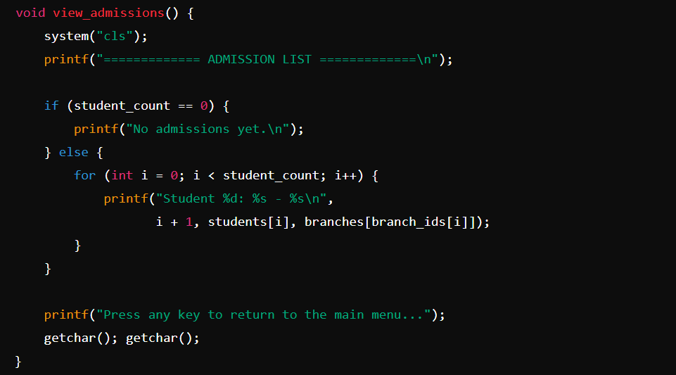
View All Admissions Sample Code Snippet:

Slide 11
Overview of View All Admissions
Clear Screen:-Clears the terminal using system("cls").
Check Admissions:-If no students are admitted (student count == 0), display "No admissions yet."
Display List: If there are admissions, loop through and display each student's name and branch.
Pause:-Wait for user input with get char() to return to the main menu.

Slide 12
Cancel Admission
Clear Screen:-The terminal is cleared using system("cls") to provide a clean interface for the user.
Check for Admissions:-The function checks if there are any students in the system (student count == 0). If there are no admissions, it informs the user and exits.
Prompt for Admission Number:-f there are admissions, the user is prompted to enter the admission number of the student they want to cancel (from 1 to student count).
Validate Admission Number:-t checks if the entered admission number is valid (between 1 and student count).
If the number is invalid, an error message is displayed.

Slide 13
Remove Student from List:-If the admission number is valid, the function removes the student from the list:
It shifts all students after the canceled one up by one position in the students array and adjusts the branch_ids accordingly.
Update Student Count:-The total student count (student_count) is decreased by 1 to reflect the canceled admission.
Confirmation:-A confirmation message "Admission cancelled successfully" is displayed.
Pause:-The function waits for user input (via getchar()) before returning to the main menu.

Slide 14
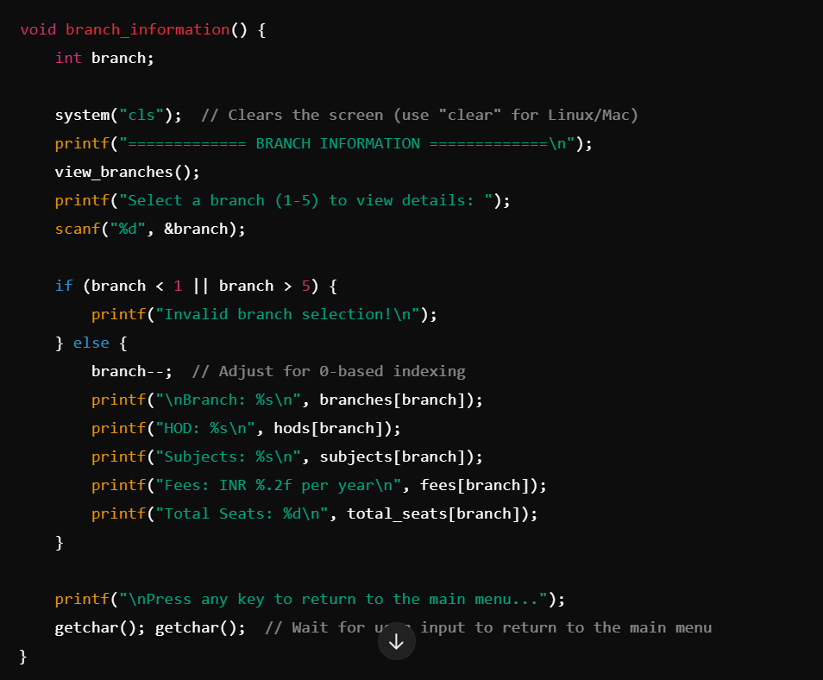
Branch Information

Slide 15
Overview of Branch Information
Clear Screen:Clears the console with system("cls"); (use system("clear"); on Linux/Mac).
Display Branch List:Calls view_branches() to show all available branches.
Prompt for Selection:Asks the user to enter a branch number (1-5) and stores it in branch.
Validate Selection:Checks if the selected branch is between 1 and 5. If not, displays an error message.
Display Branch Details:Adjusts branch for 0-based indexing with branch--.
Prints branch name, HOD, subjects, fees, and total seats using arrays.
Pause Before Returning:Waits for user input with getchar(); getchar(); before going back to the main menu.

Slide 16
Conclusion
Branch Information:-Displays details about available branches, including the Head of Department (HOD), subjects offered, annual fees, and total seats.
Menu-Driven Interface:-Users can navigate through the options like viewing branches, adding new admissions, viewing admission records, canceling admissions, and viewing branch details. Each option is organized in a structured, user-friendly menu format.
Data Storage and Management:-Uses arrays to store information on branches, HODs, subjects, fees, and seats.
Stores student names and selected branch IDs in arrays for managing admissions.
Saves admissions data to a file (admissions.txt) for persistent storage, so admission records are not lost after the program exits.

Slide 17
File Handling:-The program uses file handling to save admission details to admissions.txt, ensuring data persistence even after the program ends.
Error Handling and User Feedback:-Provides feedback for invalid inputs, such as incorrect branch selection or admission numbers, improving user experience and making
it easier to navigate.Admission Cancellation:-The system allows users to cancel a specific admission by admission number. When an admission is canceled, it adjusts the list, ensuring data consistency. This feature provides flexibility to manage changes in admissions effectively.

Slide 18
Any Question

Slide 19
Thank You !

